Slide 1
Creating Racial Equity in Your Organization
LaCheryl Porter, JD.
Chief Operating Officer
St. Joseph Center
NAEH July 23, 2019

Slide 2
ST. JOSEPH CENTER
Notes:
Before I get into how SJC is beginning to address racial disparities within our organization I want to start with telling you a little bit about our St. Joseph center and how it was introduced to the organization

Slide 3
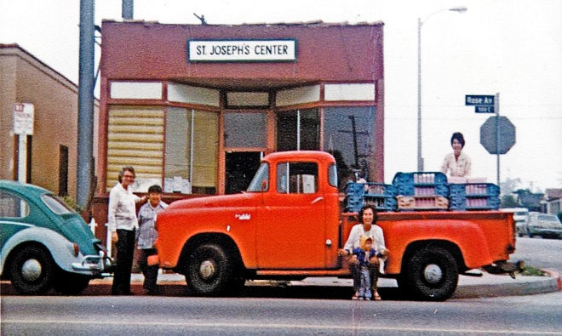
SJC OVERVIEW | RACIAL DISPARITIES | DEFINING: HOW? | CREATING RACIAL EQUITY | DISCUSSION
St. Joseph Center’s mission is to provide working poor families, as well as homeless, men, women and children of all ages, with the inner resources and tools to become productive, stable and self-supporting members of the community.
St. Joseph Center (SJC) was founded on July 8, 1976 by two Sisters of St. Joseph of Carondelet. Though we are a separately incorporated 501(c)(3) non- profit organization, we retain an affiliation with the Sisters as a “Sponsored Institution.”

Slide 4
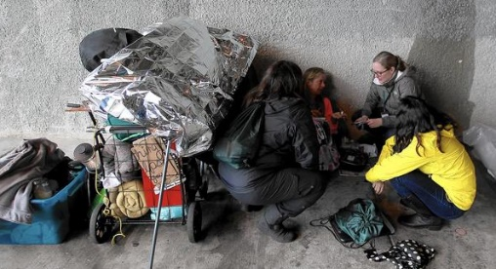
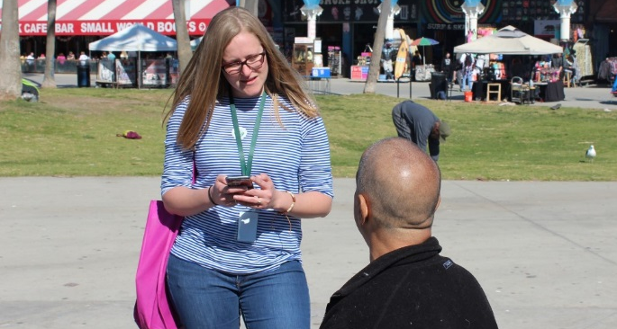
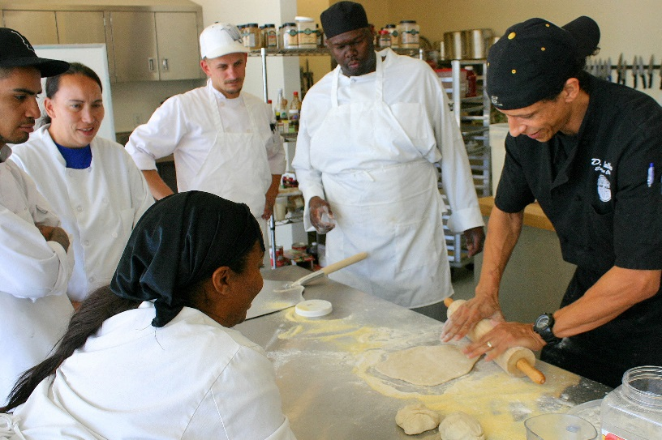
SJC OVERVIEW | RACIAL DISPARITIES | DEFINING: HOW? | CREATING RACIAL EQUITY | DISCUSSION
Outreach & Engagement 5,610 homeless men, women, and children engaged 2,202 of these people were successfully linked to services/ enrolled in housing program 27,000 hot, nutritious meals served to homeless men and women at Bread and Roses Café 150,000 meals prepared at home by Food Pantry clients using groceries received from St. Joseph Center | Housing 472 homeless people placed in permanent housing 1,000 formerly homeless men, women, and children assisted to retain housing Mental Health 333 men, women, and children benefitted from life-changing mental health services | Education & Vocational 42 men and women graduated from our Culinary Training Program; 75% found jobs 35 women graduated from Codetalk, our web development training program; 75% found jobs 60 children ages 18 months to 5 years old received educational and enriching childcare
*FY 17-18 Totals

Slide 5
Racial Disparity
Racial inequality in the United States identifies the social advantages and disparities that affect different races within the United States.
These can also be seen as a result of historic oppression, inequality of inheritance, or overall prejudice, especially against minority groups.

Slide 6
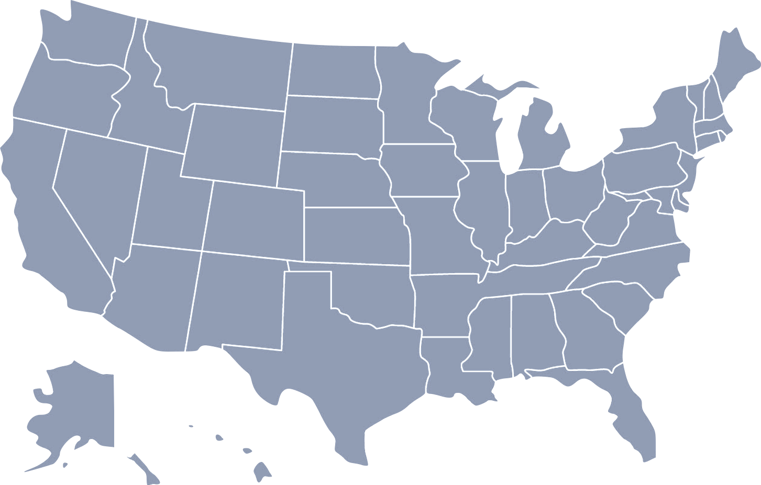
SJC OVERVIEW | RACIAL DISPARITIES | DEFINING: HOW? | CREATING RACIAL EQUITY | DISCUSSION
Racial Disparities Data
United States |  | General Population | Deep Poverty | Homeless
 | White | 73.8% | 59.7% | 48.6%
 | Black | 12.4% | 23.5% | 42.6%
 | American Indian and Alaska Native | 0.8% | 1.6% | 2.5%
 | Asian | 5.2% | 4.6% | .8%
 | Native American and Other Pacific Islander | .2% | .2% | 1.1%
 | Two or more races | 3.0% | 3.9% | 4.6%
 | Hispanic/Latinx (of any race) | 17.2% | 24.3% | 16.9%
Source: SPARC, 2018

Slide 7
Racial Disparities: Los Angeles County
SJC OVERVIEW | RACIAL DISPARITIES | DEFINING: HOW? | CREATING RACIAL EQUITY | DISCUSSION
White households are more likely to be homeowners (68%), in comparison to the 44% and 45% of African American and Latino households, respectively.
White households have a median net worth of $355,000, compared to $72,000 for Black households.
In 2016, the average salary for miscellaneous management roles held by a White worker was $107,638, and for Black/African Americans that number decreased to $74,364.60 (Source: Census Bureau, 2018).
Source: Duke University Research Network on Racial and Ethnic Inequality, The Color of Wealth in Los Angeles, 2016

Slide 8
How Did We Get Here?
SJC OVERVIEW | RACIAL DISPARITIES | DEFINING: HOW? | CREATING RACIAL EQUITY | DISCUSSION
Explicit Racial Bias
Implicit Racial Bias
Definition
Definition
Refers to the attitude and beliefs we have about a racial group on a conscious level
Refers to the attitude and beliefs we have about a racial group on a unconscious level
Manifestations
Manifestations
discrimination, stereotyping, hate speech, violence, exclusionary practices, lack of empathy, favoritism
discrimination, stereotyping, micro-aggressions, violence, exclusionary practices, lack of empathy, favoritism

Slide 9
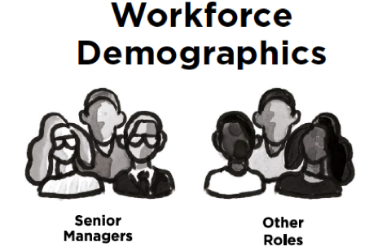
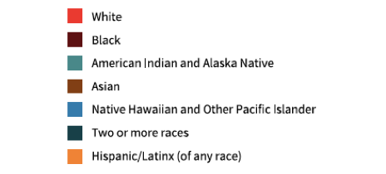
SJC OVERVIEW | RACIAL DISPARITIES | DEFINING: HOW? | CREATING RACIAL EQUITY | DISCUSSION
Implicit bias can affect:
Who gets hired
Who managers trust with assignments
Who gets promoted
Does our provider workforce reflect the racial diversity of those we serve?
Source: SPARC, 2018

Slide 10
SJC OVERVIEW | RACIAL DISPARITIES | DEFINING: HOW? | CREATING RACIAL EQUITY | DISCUSSION
Employment discrimination: In Los Angeles County, Black people also face systematic discrimination in the labor market and are most affected by the high cost of living.
A recent study shows a 50% gap in resume callback rates between Black-associated names and those with names traditionally associated with White people. (National Bureau of Economic Research)
Black workers in Los Angeles County experience higher rates of unemployment and earn wages less than three-quarters of those earned by White workers, and Black households have the lowest median income of any racial group. (University of California, Los Angeles Labor Center, the Los Angeles Black Worker Center, and the UCLA Institute for Research on Labor and Employment)
Source: Ad Hoc Committee Report on Black People Experiencing Homelessness

Slide 11
SJC OVERVIEW | RACIAL DISPARITIES | DEFINING: HOW? | CREATING RACIAL EQUITY | DISCUSSION
St. Joseph Center Staff Demographics
Source: SPARC, 2018

Slide 12
SJC OVERVIEW | RACIAL DISPARITIES | DEFINING: HOW? | CREATING RACIAL EQUITY | DISCUSSION
St. Joseph Center Staff Demographics (Cont.)

Slide 13
Creating Racial Equity
SJC OVERVIEW | RACIAL DISPARITIES | DEFINING: HOW? | CREATING RACIAL EQUITY | DISCUSSION
Strategic intention from the highest level –
CEO and Executive Team committed to increasing diversity
with respect to race and educational status
Intentionally recruited service providers who had experienced homelessness and/or incarceration
Softened degree requirements whenever possible, and even removed degree requirements for a number of positions
Diversified staff at all levels

Slide 14
Intentional Recruitment
SJC OVERVIEW | RACIAL DISPARITIES | DEFINING:HOW? | CREATING RACIAL EQUITY | DISCUSSION
Hiring a Diverse Workforce:
History of Homelessness
Mental illness
Substance abuse
Domestic violence
History of Incarceration

Slide 15
Modified Employee Eligibility Requirements
SJC OVERVIEW | RACIAL DISPARITIES | DEFINING: HOW? | CREATING RACIAL EQUITY | DISCUSSION
Inclusive Job Descriptions
Education:
Bachelor’s degree from an accredited college or university in social work, human services or a related field; a combination of education and experience may be substituted.
Lowered educational barriers for the following positions:
Peer Advocate
Peer Specialist
Representative Payee
Housing Locator
Housing Navigator
Certain Case Manager positions

Slide 16
Hiring a Diverse Workforce
SJC OVERVIEW | RACIAL DISPARITIES | DEFINING:HOW? | CREATING RACIAL EQUITY | DISCUSSION
Created a new process to not immediately eliminate people with a history of involvement with the legal system.

Slide 17
Supporting a Diverse Workforce
SJC OVERVIEW | RACIAL DISPARITIES | DEFINING:HOW? | CREATING RACIAL EQUITY | DISCUSSION
Expanded the minimum “Cultural Competency” to “Cultural Humility” during new staff orientation.
Created a space and process for Executive Management to get input from staff who want to support diversity.
Staff lead Social Committee expanded their mission and focus.
As and organization we recognize that diversity is beyond race and gender.

Slide 18
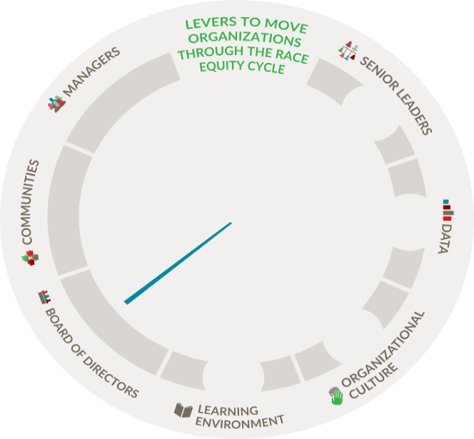
Building a Race Equity Culture: The Race Equity Cycle
SJC OVERVIEW | RACIAL DISPARITIES | DEFINING: HOW? | CREATING RACIAL EQUITY | DISCUSSION
AWAKE
Focus on people and on building a workforce and boards comprised of individuals from different race backgrounds
WOKE
Focus on culture and creating an environment where everyone is comfortable sharing their experiences, and everyone is equipped to talk about race equity and inequities
WORK
Focus on systems to improve race equity
Source: Equity in the Center, 2018

Slide 19
Building a Race Equity Culture: The Role of Levers
SJC OVERVIEW | RACIAL DISPARITIES | DEFINING: HOW? | CREATING RACIAL EQUITY | DISCUSSION
Senior Leadership
Individuals in a formal leadership role
Management
Individuals who oversee operations of teams
Board of Directors
Governing body of an organization
Community
Populations served by the organization
Learning Environment
Investment in staff capacity
Data
Metrics to drive improvements and focus
Organizational Culture
Shared values, assumptions, and beliefs
Source: Equity in the Center, 2018

Slide 20
Building a Race Equity Culture: Envisioning A Race Equity Culture
SJC OVERVIEW | RACIAL DISPARITIES | DEFINING: HOW? | CREATING RACIAL EQUITY | DISCUSSION
Leadership ranks hold a critical mass of people of diverse backgrounds
Evaluation efforts incorporate the disaggregation of data
Expenditures reflect organizational values and a commitment to race equity
Continuous improvement in race equity work is prioritized
Source: Equity in the Center, 2018

Slide 21
Benefits of A Diverse Workplace:
SJC OVERVIEW | RACIAL DISPARITIES | DEFINING:HOW? | CREATING RACIAL EQUITY | DISCUSSION
Increase in Cultural Empathy and Community/Client Engagement
Staff, stakeholders, and leaders are skilled at talking about race, racism, and their implications
Programs are culturally responsive and explicit about race, racism, and race equity
Communities are treated as stakeholders, leaders, and assets to the work

Slide 22
Thank You
LaCheryl Porter, J.D.
lporter@stjosephctr.org

