Slide 1
Host Homes for Youth Experiencing Homelessness
Pilar Barreyro, Associate Director, Northeast & Strategic Communications, Point Source Youth

Slide 2
POINT SOURCE YOUTH

Slide 3
POINT SOURCE YOUTH
SERVICES
Advocacy (Build community support for program, assist with funding meetings)
Technical Assistance (Intensive, in-person TA to help with program funding and implementation, hiring/training staff, ongoing support and troubleshooting, connecting with field experts and other providers and access to a growing resource library and program handbooks)
Evaluation (Pay youth participants to take surveys on their experiences in the program and well-being at three month intervals, build support for interventions through published quantitative and qualitative data)

Slide 5
How Point Source Youth Can Help
Host-Guest Matching Process
Host Applications and Reference Requests
Budget Assistance
Staffing and Hiring Processes
Recruiting and Engaging Hosts
Youth Applications
Marketing Materials
Advising Length of Stay
Planning and Leading Host Home Trainings
Connecting Experts and Leaders in the Space

Slide 6
Host Homes Handbook 2.0
Free PDF available for download and order one free hard copy at: www.pointsourceyouth.org

Slide 7
BEST PRACTICES FOR TRAINING HOSTS

Slide 8
Engage the Community
Volunteers/ Supporters
Presentations
Flyers
Targeted Facebook Ads
Local Media
Email Blasts
Word of mouth

Slide 9
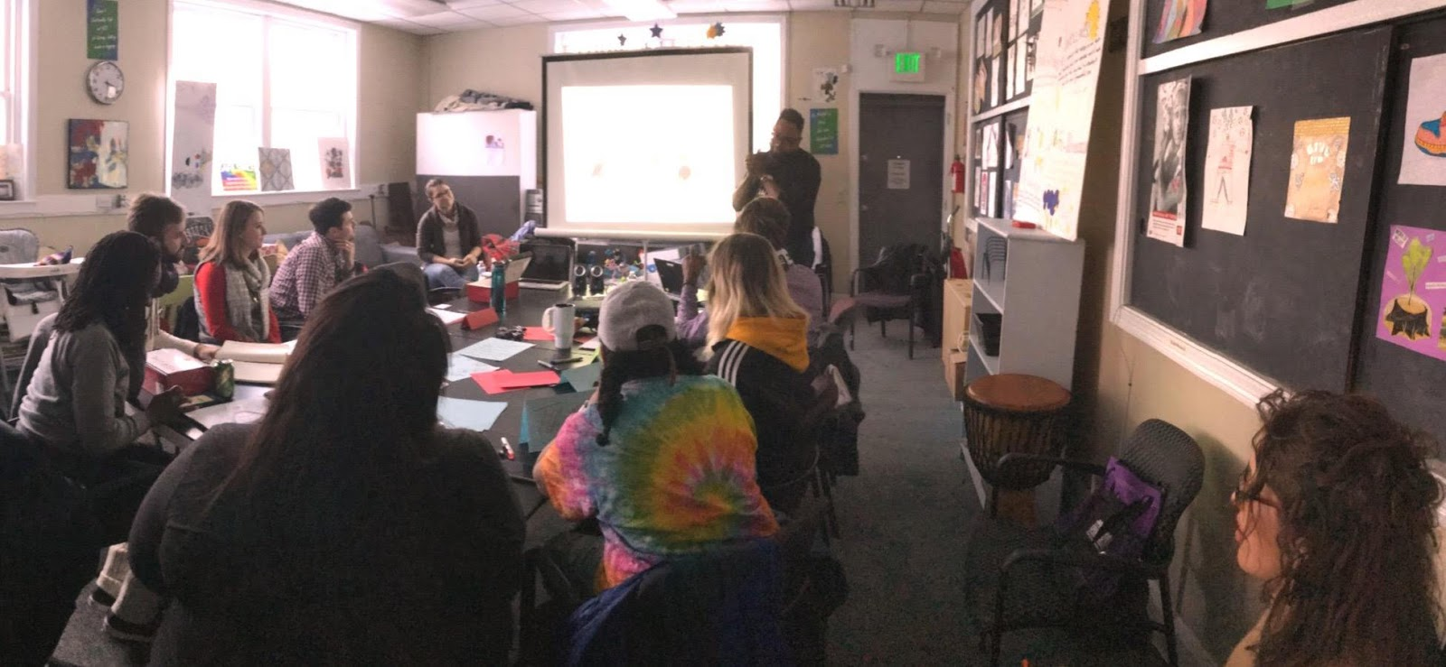
Respect Folks’ Time
Regular and ongoing host home trainings provide the opportunity for follow up.
Create a training schedule & be flexible
Weekdays & Weekends
Training recommendations:
1 day
4-6 hours
St. Ambrose Housing Aid Center
Baltimore, MD

Slide 10
Addressing Community Needs
Developing a common ground for participants. You, young folx & common themes:
Assertive Communication
LGBTQ 101
Power & Privilege
Trauma & Resiliency
Adultism
Biases

Slide 11
Creating Dialogue
Opportunity for Questions
Group Discussion Activities
Check for Understanding
Conversations with former participants

Slide 12
Ongoing Support
Monthly host dinners allow folks to discuss challenges, successes, and provides an opportunity for continued training.
Refresher topics:
Assertive communication
Conflict resolution
Goal setting & support

Slide 13
EQUITY PRACTICES

Slide 14
Equity Practices
Keys to Success
Low barrier housing/housing first
Case management centers resources for youth, especially for LGBTQ youth & youth of color
Host Stipends
Required host trainings include a focus on supporting trans youth, LGBTQ youth, youth of color, intersectionality, as well as addressing white privilege

Slide 15
YOUTH LEADERSHIP

Slide 16
Youth Leadership
Keys to Success
Youth Advisory Boards
Youth on hiring committees for agency staff (program managers, case managers, etc.)
Youth selection of hosts as part of matching process
Youth & Host contracts
Peer Movers & paid positions

Slide 17
DATA FROM HOST HOME PILOTS

Slide 18
What the Data Shows
Early Results From Host Home Pilots
Need for long term job/ vocational training
Participants are accessing jobs, however mostly part time, temporary
Stable access to food
Ensuring folks are applying for EBT and SNAP benefits and receiving support for assessing nutritional food
Sleep stressors
Although their environment has changed, participants still have trouble falling asleep
Need for agency approach
Participants feel well connected with wraparound staff support (not just from the HH program employee)
Staff x HH Participant Communication is the key to success!
Petering, 2019

Slide 19
FREQUENTLY ASKED QUESTIONS

Slide 20
What are the protections and oversights that are in place to ensure that as best as can be--we have a safe and secure and affirming environment for the youth in host homes?
Why should there be diversity amongst host homes?
What happens if a host has a vacation or needs to go out of town while hosting a youth?
What does it mean to have youth choice?
How are host homes different from foster care? How do host stipends differ from foster care payments?
What if there’s conflict between hosts and youth?

Slide 21
TAKEAWAYS

Slide 22
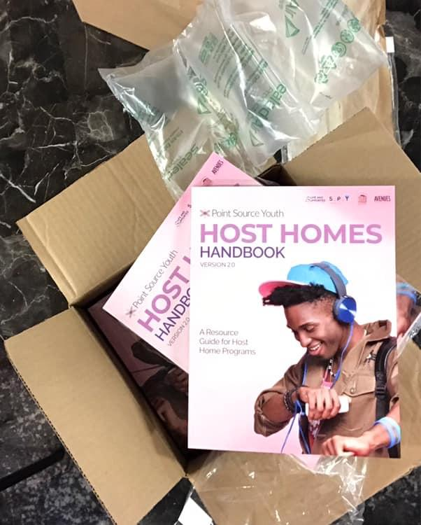
Don’t Recreate the Wheel
Take advantage of the wealth of knowledge built up on host homes nationally
Monthly Group & Individual Meetings
PSY can connect you with other agencies successfully implementing host homes now
Host Homes Handbook 2.0
Real time problem solving

Slide 23
SAVE THE DATE
1st Annual Southern Symposium on Solutions to End Youth Homelessness
September 16 & 17, 2019
Atlanta, GA

Slide 24
CONTACT US!
Pilar Barreyro Associate Director, Northeast & Strategic Communications Email: pilar@pointsourceyouth.org

