Slide 1
National Alliance to End Homelessness
July 22-24, 2019
Fred Gigliotti M.S.W., Director of Emergency and Temporary Housing, Office of Homeless Services, Philadelphia

Slide 2
Lower Barriers Does Not Mean Lower Expectations: Engaging People in New Ways in Emergency Shelter
The Philadelphia Office of Homeless Services is the government agency tasked to make homelessness rare, brief and non-recurring in Philadelphia
30 year round shelters for individuals and families experiencing homelessness with a total capacity of nearly 2,800 beds
Homeless Intake Access Points which sees more than 20,000 people a year, diverting nearly half from shelter entry
Financial Assistance (Prevention) to more than 1,000 households in to prevent homelessness
Expanded capacity in winter months

Slide 3
Conversion to Low Barrier
Housing First approach identified as the model which was HUD driven
Culture change starting from OHS driving the new direction
Housing First/Housing Focused Trainings offered to shelter providers
Revised Emergency Shelter Standards moving from punitive to empowering
Emphasis on philosophical shift that we no longer should police behavior
OHS Shelter Director visited every shelter to communicate changes to both staff and participants

Slide 4
Creating a set of Expectations
Honest exploratory conversations upon first meeting with Case Manager
Continued attempts to divert or prevent further homelessness once sheltered including one-time rental assistance if the participant identifies a place to live
Rapport building: Empower people using techniques from motivational interviewing
Create a tangible sense of urgency particularly for participants with low vulnerability
Participants Rights and Expectations: Develop a Housing Plan/Housing Agreement
Low Vulnerability Pilot: 20% of shelter participants score in low vulnerability range

Slide 5
Transition with Purpose to Low Barrier Services
Evaluate and eliminate shelter rules that do not have a health and safety concern
This eliminates “power and control” tension between staff and participants
If you cannot explain the “why” of a rule with a straight face, it probably should not be a rule
Ask participants their experience with housing before entering shelter, including past scenarios
Tailor the housing plan to the reason for homelessness. Eviction history vs family discord creates a different housing plan. Keep conversations real, no judgement on what happened that led to the experience of homelessness

Slide 6
Emergency Housing Standards: The Guiding Document
Guiding Principles: Housing First, Housing Focused, Prioritization based on vulnerability, Person Centered, Strength Based
Shelter Rules and Policies must not be punitive, restrictive, or designed to control behavior
Participants Rights are emphasized
Included is the right to be informed of the consequences of threats to health and safety
The right to appeal a shelter’s decision of Health and Safety Exit to OHS

Slide 7
Shelter is a Process not a Destination
Be consistent, fully transparent and honest
Set reasonable expectations from the start
Subsidized Housing is not guaranteed nor an expectation
Be creative (shared housing, affordable housing in other communities)
Encourage savings by messaging that saving money while in shelter is investing in themselves
Re-focus on the “business” of personal finance and housing, instead of the “behavior” of participants
Remember that most participants can be successful with a light touch of service, save the resources for the most vulnerable in your communities

Slide 8
Spring Point in Time Data
Street Count Spring 2019: 828
Street Count Spring 2018: 895
Singles in shelter Spring 2019: 1301
Singles in Shelter Spring2018: 1113
Family Members in Shelter Spring 2019: 1262
Family Members in Shelter Spring 2018: 1379
OHS increased resources for singles to assist in reducing the number of people on the street, which was largely driven by the City’s Opioid Crisis

Slide 9
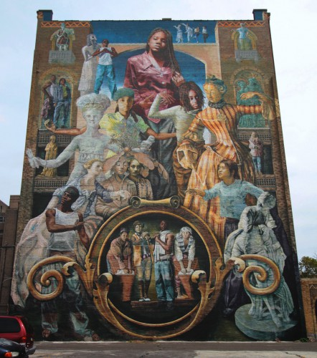
For more information:
Fred Gigliotti, Director of Emergency and Temporary Housing
Office of Homeless Services, City of Philadelphia
Frederick.gigliotti@phila.gov

