Slide 1
Helping People Pay the Rent in Rapid Re-housing Programs NAEH Conference July 2019 Session 2.02
Suzanne Wagner
swagner@housinginnovations.us
Notes:
Temporary financial assistance, or PAY, is one of the three core components of rapid re-housing. This workshop will examine how communities and programs are structuring financial assistance to provide services that are flexible and individualized to the needs of each household. Speakers will also share how they prepare individuals and families to transition off rental assistance as services end.

Slide 2
Session Overview
Framing Concepts and Considerations
Lessons from Crossroads Rhode Island
Lessons from Community Builders, Grand Rapids MI
Q&A
Notes:
Temporary financial assistance, or PAY, is one of the three core components of rapid re-housing. This workshop will examine how communities and programs are structuring financial assistance to provide services that are flexible and individualized to the needs of each household. Speakers will also share how they prepare individuals and families to transition off rental assistance as services end.

Slide 3
Core Components of Rapid Rehousing
Quick Exit to Permanent Housing
Housing Identification
Rental & Move In Assistance
Housing Stabilization
Case Management Services

Slide 4
Strengths-based
Individualized
Culturally sensitive
Transparent
Trauma-informed

Slide 5
Themes in Helping People Pay the Rent
Flexible and individualized
Use progressive engagement and start with the smallest amount of assistance
Be creative
Have resources to fill gaps
Fair and transparent standards
Plan for end of assistance from the beginning
Notes:
Temporary financial assistance, or PAY, is one of the three core components of rapid re-housing. This workshop will examine how communities and programs are structuring financial assistance to provide services that are flexible and individualized to the needs of each household. Speakers will also share how they prepare individuals and families to transition off rental assistance as services end.

Slide 6
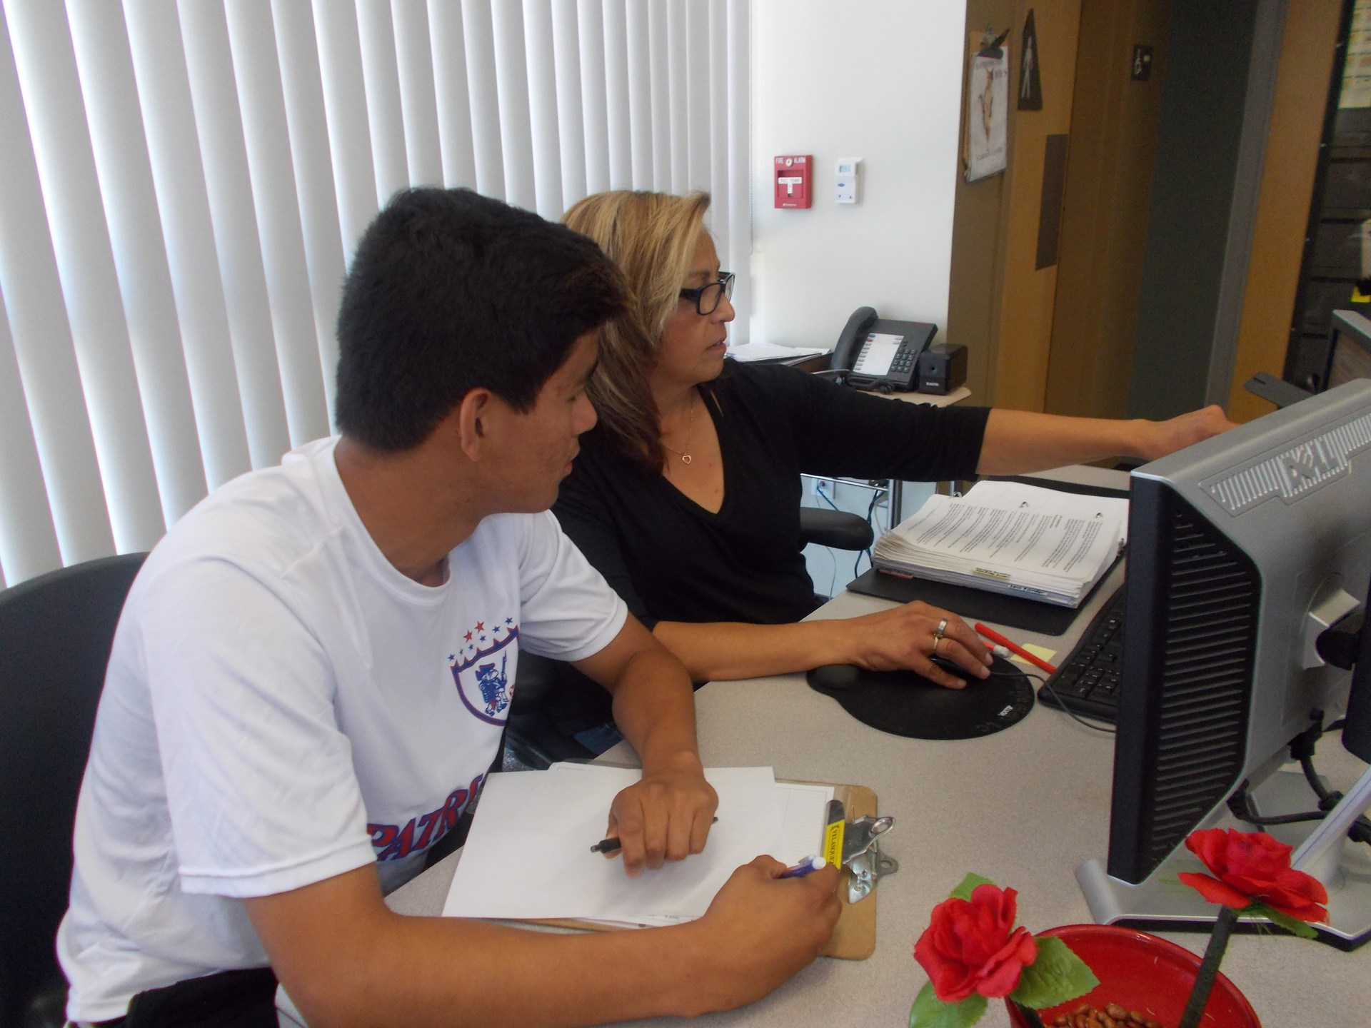
How to Be Flexible and Individualized
Assessment
Focused domains: Housing, Income, Supports
Hear what clients think they need and how they have managed in past
Planning for Short-Term Assistance
Develop a focused housing stabilization plan
Use a problem-solving approach
“What are your ideas about how to resolve this housing crisis?”
Short-term actionable goals driven by participant
Assess viability of current situation for the long-term and engage participants in evaluative discussion
Connections to resources - networks of care, warm handoffs
Notes:
Temporary financial assistance, or PAY, is one of the three core components of rapid re-housing. This workshop will examine how communities and programs are structuring financial assistance to provide services that are flexible and individualized to the needs of each household. Speakers will also share how they prepare individuals and families to transition off rental assistance as services end. Temporary financial assistance, or PAY, is one of the three core components of rapid re-housing. This workshop will examine how communities and programs are structuring financial assistance to provide services that are flexible and individualized to the needs of each household. Speakers will also share how they prepare individuals and families to transition off rental assistance as services end.

Slide 7
Flexible and individualized - 2
Broad array of landlord and service partnerships
Skilled Staff
Consultation/supervision/training
Regular case reviews
Share lessons, resources and successes
Revision to the Housing Plan
Update as frequently as needed
Standards and Waivers of same
Small amounts and short increments
Increase/extend when needed
Clear criteria for when housing crisis is resolved
Exception Process
Review outcomes and practices regularly and adjust

