Slide 1
2:09 Uniting Homeless Service Partners Around A Common Vision to End Family homelessness
Carrie Poser – CoC Director, WI Balance of State CoC
July 2019

Slide 2
CoC Basics
The WI Balance of State CoC is a 501c3 non-profit organization that covers all of Wisconsin except Dane, Milwaukee, & Racine counties. There are 21 “members” or local homeless coalitions, a volunteer Board of Directors, and 4 paid staff.
Share a state-wide HMIS system, HMIS lead, & governance
The geography includes:
A population of approximately 3.8 million people
Covers over 62,000 square miles
Takes approximately 6 hours to travel north to south, 4 hours to travel east to west
Bordered by the Mississippi River, Lake Superior, and Lake Michigan
69 different counties, 15 consolidated plan jurisdictions, 11 Native American tribes
With the largest county being Waukesha (396,488) and the largest city being Green Bay (105,207)

Slide 3
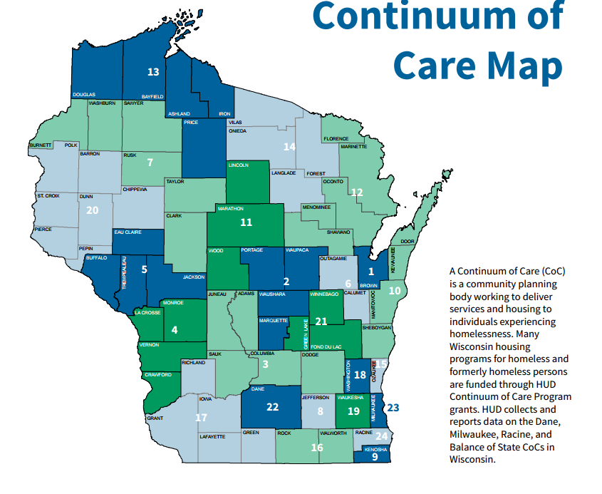
http://www.icalliances.org/wisconsin/

Slide 4
Funding
Total CoC FY2018 award = $10,365,263.
46% PSH, 38% RRH, 2% TH
HMIS $371,429 (Institute for Community Alliances)
The BOS receives three direct HUD awards: CoC planning ($294,945), SSO-CE ($640,469) & DV RRH ($1,002,663).
The total EHH (ESG + 2 state pots of funding) FY2018 from State of WI = $3,657,448.
Support 20 lead agencies (including the BOS) & 58 sub-recipient organizations
Services include: emergency shelter, rapid re-housing, prevention, HMIS & outreach
For Veterans:
There are 5 different VAMCs with 10 housing authorities and one Tribal Housing Authority administering HUD-VASH Vouchers (343 vouchers).
There are 3 different non-profits administering Supportive Services for Veteran Families (SSVF) funds across the Balance of State ($3,192,107)*. *This numbers includes some funding for Milwaukee and Racine.

Slide 5
Data
During the Jan. 2019 PIT count, there were 4,538 people experiencing homelessness on 1 night in Wisconsin.
Balance of State makes up 63% of State total
BOS Total = 2,875 *decrease from 3,147 (2018)
51% in households with children
49% in households without children
BOS Veterans = 195 *increase from 165 (2018)
BOS Chronic = 340 *increase 285 (2018)
BOS Unsheltered = 94 *decrease from 127 (2018)
ICA created an interactive graphic to illustrate local system performance measure impact. https://www.icalliances.org/local-system-performance-measures

Slide 6
Family Homelessness
According to the January PIT data:
Since 2015, the Balance of State has experienced a 30% reduction in family homelessness.

Slide 7
Family Homelessness
According to Coordinated Entry data:
7.17.19
There are 1,960 singles and 717 households with children identified.
5.18.18
There were 1,777 singles (66%) and 898 households with children (34%) identified.

Slide 8
Coordinated Entry
CoC-wide system access is No Wrong Door.
20 coalitions with a Local CE lead and Non-HMIS list holder
Each coalition has 4 lists: HMIS - HH with kids, HMIS - HH w/out kids, HMIS - prevention, & Non-HMIS.
Approved 2.0 Manual and order of priority across CoC
Realistic look at need at the Balance of State level
Increase PSH units and/or enhance moving up strategies to free up units
HH w/out children (347+211 = 558) HH w/children (43+32 = 75) Total = 633 units
Increase RRH units with intensive case management (similar to PSH level if needed)
HH w/out children (897) HH w/children (226) Total = 1,123 units
Focus other RRH units on lower barrier (less than 12 months of homeless, no disability)
HH w/out children (357) HH w/children (235) Total =592 units

Slide 9
Common Vision
CoC Governance
Regional representation to each local coalition represented
Expanded Coordinated Entry System
Increase from 12 coalitions funded to 19 (with SSO grant)
Adding Tools to the Toolbox
CoC funding is a hammer. Stop trying to use it like a screwdriver.
Advocacy at state level for more funding and new funding across homeless crisis response system – invest in housing navigation, diversion, landlord repairs, increase shelter funding based on performance and expand case management funding
Alternative funding means more flexibility
And . . .

Slide 10
Coalition Engagement
21 very different coalitions
Provider knowledge and understanding vs. general public vs. other systems of care
What is the Balance of State? Why should I care?
Opportunity to listen and answer questions
60+ slide presentation, 3 hours, invite media, advertise!
Showcase local coalition data – contribution to system performance, comparison to similarly situated communities, point-in-time data, and coordinated entry data
Expand understanding of federal priorities, departments, regulations, and systems
Dig into the components of a homeless crisis response system
Address concerns regarding prioritization and housing first

Slide 11
Examples

Slide 12
SPM Measure #3: Total Clients Experiencing Homelessness
10.1.16 – 9.30.17
http://www.wiboscoc.org/system-performance-measures.html
All Persons
Coalition | Total Number
Kenosha | 674
Waukesha | 943
Dairyland | 734
North Central | 674
Kenosha | Total Number | % Change
2014 | 777
2015 | 839 | +8%
2016 | 829 | -1.2%
2017 | 674 | -18.7%
Overall decrease in total clients experiencing homelessness since 2014 in Kenosha is: -13%.

Slide 13
Point-in-Time – Dairyland Coalition
January PIT (2013-2018)
 | Balance of State | % of Homeless in Dairyland | # people | # unsheltered | # veterans | # CH
2013 | 3610 | 5% | 181 | 11 | 9 | 5
2014 | 3569 | 5% | 177 | 10 | 5 | 23
2015 | 3590 | 5% | 180 | 1 | 8 | 23
2016 | 3438 | 4.3% | 148 | 5 | 8 | 16
2017 | 3348 | 5% | 166 | 7 | 7 | 10
2018* | 3147 | 5% | 160 | 7 | 10 | 19
Since 2013, the Balance of State total PIT count has decreased: -7.3%
Since 2013, the Dairyland’s total PIT count has decreased: -11.6%
 | Total People | People in HH w/children | People in HH w/out children
2013 | 181 | 99 (55%) | 82 (45%)
2014 | 177 | 106 (60%) | 71 (40%)
2015 | 180 | 100 (56%) | 80 (44%)
2016 | 148 | 78 (53%) | 70 (47%)
2017 | 166 | 88 (53%) | 78 (47%)
2018 | 160 | 52 (33%) | 108 (67%)

Slide 14
What does all this mean?
Enhance efforts to expand list
Ensure all shelters are referring all clients to the list
Expand outreach & marketing efforts
Include other systems of care - human services, housing authority, school districts, rural county providers
Realistic look at need at the Balance of State level and the local coalition level
Increase PSH units and/or enhance moving up strategies to free up units
HH w/out children (2+1 =3) HH w/children (0) Total = 3
Increase RRH units with intensive case management (similar to PSH level if needed)
HH w/out children (22) HH w/children (2) Total = 24 units
Focus other RRH units on lower barrier (less than 12 months of homeless, no disability)
HH w/out children (5) HH w/children (5) Total = 10 units

Slide 15
Prioritizing Housing Resources
To end homelessness for everyone waiting for housing today:
Enroll 5 HH in PSH or PSH-level case management services
Assist the 6 HH that scored less than a 4 to self-resolve, utilize natural resources and mainstream benefits
Enroll 37 HH in RRH with intensive, more PSH-like case management services
1st priority = the 21 HH with 9+ VISPDAT score
2nd priority = the 12 HH with a VISPDAT score between 4-8
Enroll 35 HH in RRH with less intensive case management
3rd priority = the 15 HH with a 9+ VISPDAT score
4th priority = the 18 HH with a VISPDAT score between 4-8

