Slide 1
Systems Background in MA
MA Department of Public Health
Funds Domestic Violence Shelters and
Housing Stabilization Services for people experiencing DV
MA Department of Housing and Community Development
Sole funder of statewide family shelter system
Primary funder of statewide shelter system for individuals
Collaborative Applicant for Balance of State CoC
Massachusetts has 15 CoCs
13 Coordinated Entry Systems

Slide 2
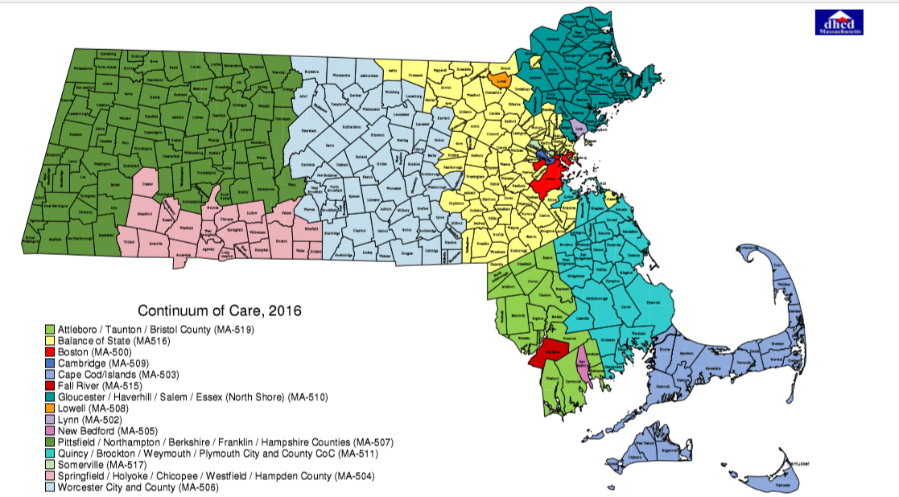

Slide 3
Strategic Partnerships
Statewide (large system) DV advocates or providers
Local DV providers already doing CoC work
Persons who have experienced homelessness
Coordinated Entry staff or administrators
Your Legal folks

