Slide 1
DC Department of Human Services
2019 National Conference on Ending Homelessness
Think Before You Build: Assessing Your Crisis Response
July 23, 2019

Slide 2
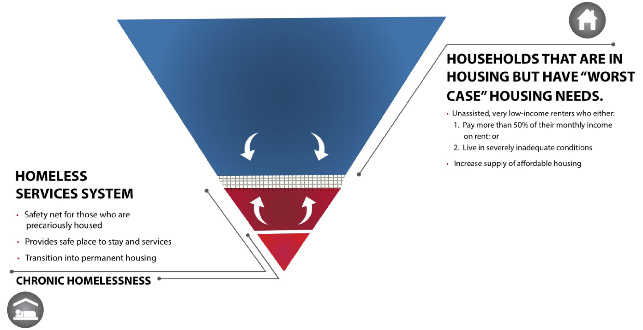
Affordable Housing and Homelessness Needs in the District

Slide 3
Three Keys to Assessing
Your Crisis Response System
Continuously monitor your system’s capacity, inflows, and outflows | Seasonality, economic conditions, demographics, and productivity are all working in concert to impact your volume
Understand Deeper Patterns of Use | Beneath total shelter utilization, there are sub-patterns that reveal opportunities to improve targeted interventions
Build, sequence, and target your interventions accordingly | Cost effectiveness requires delivering the right intervention to the right person at the right time.

Slide 4
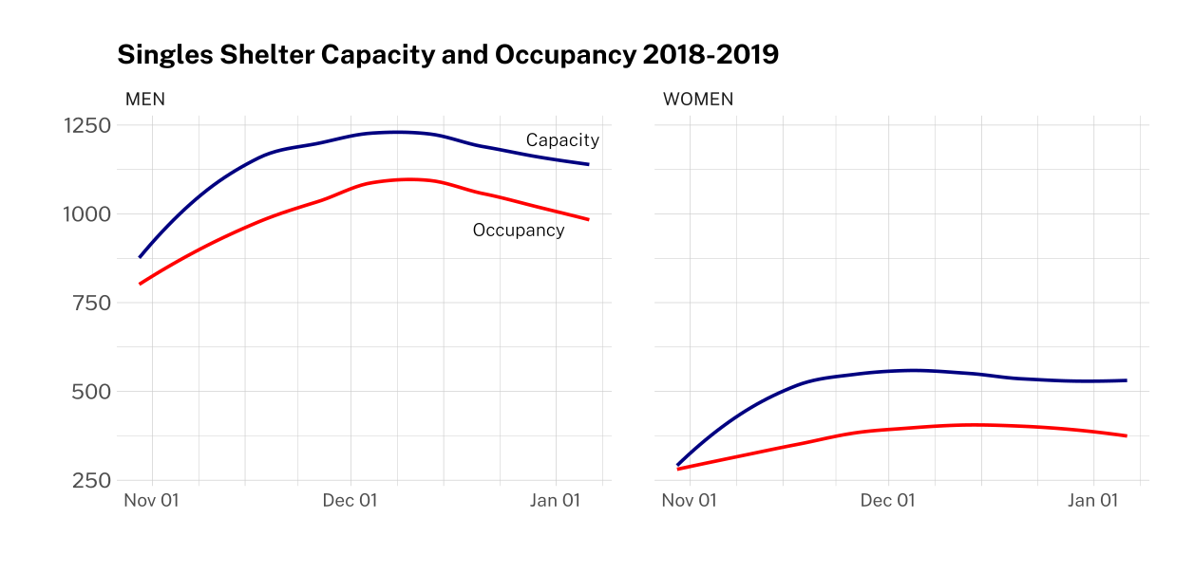
1. Continuously Monitor Your System Capacity
In the course of one year, the District can see ~12,00 unaccompanied adults experiencing homelessness - we keep six shelters open year round, but nearly double that capacity in the winter.
Although males make up a larger share of our unaccompanied population, we struggle to keep pace with the capacity needs for women in our system.

Slide 5
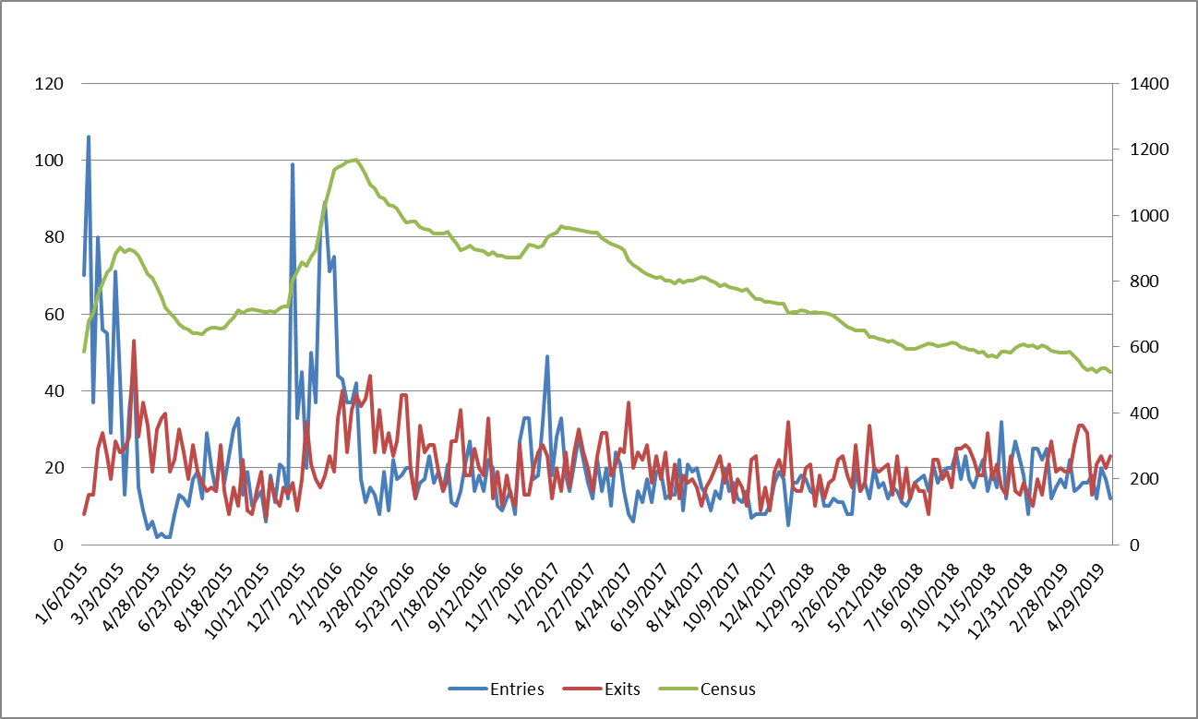
1. Continuously Monitor Your System Capacity, Inflows & Outflows
The District’s family system maintains year-round access, so we focus on monitoring inflows and outflows to ensure we continue net reductions in our overall census.
Over the past year, we’ve seen an average of 77 families enter our shelter system each month, and we’ve exited an average of 88 families each month.
Since our peak in February 2016, DHS and our partners have reduced family homelessness by 60%.

Slide 6
2. Understand Deeper Patterns of Use
43%
9%
33%
85 days
of males and 34% of females had 3-5 episodes that averaged 5 years apart, so they hadn’t “resolved” their homelessness at all.
of clients are unlikely to “resolve” but have not yet stayed beyond the median LOS - strong candidates for rapid exit resources.
of clients lived elsewhere prior to experiencing homelessness here, which makes community reconnection critical
is the average LOS for families leaving our newest shelters, versus 196 days for those leaving our overflow hotels.
RECURRENCE PATTERNS
COHORT PATTERNS
REGIONAL PATTERNS
LENGTH OF STAY PATTERNS

Slide 7
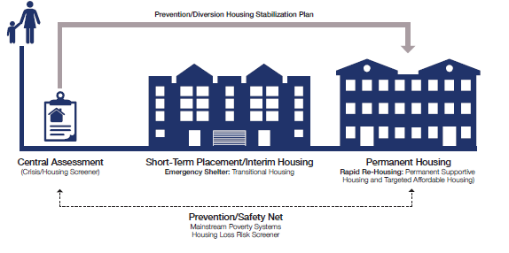
3. Build, Sequence, & Target Your Interventions Accordingly

Slide 8
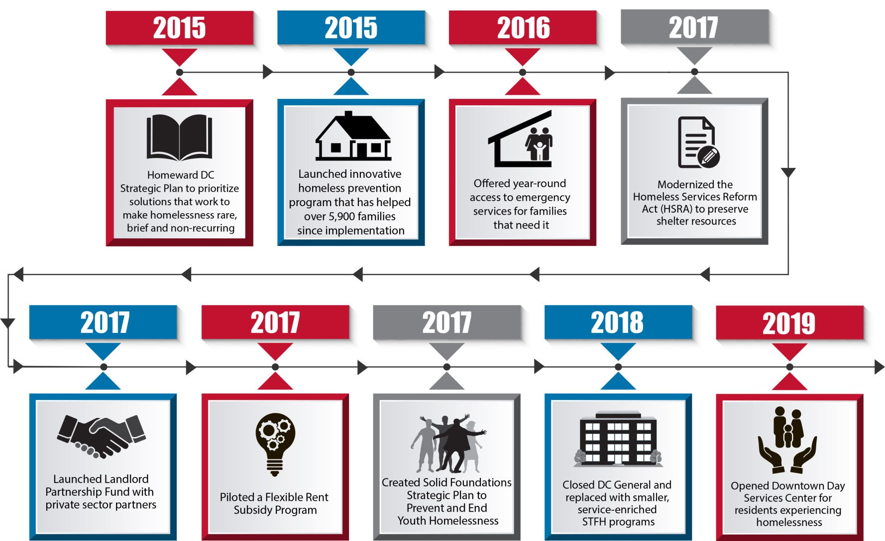
3. Build, Sequence, & Target Your Interventions Accordingly

Slide 9
Follow-Up Questions: Laura Zeilinger, Director DC Department of Human Services Laura.Zeilinger@dc.gov

Slide 10
Background Slides

Slide 11
Families System Projections
FY2018
FY2019
FY2020
DHS started FY2019 with 1,658 families in FRSP, and expects to add an average of 76 families each month while exiting 62—resulting in a net increase of 173 families by the end of the FY.
DHS started FY2018 with 1,242 families in FRSP, but added an average of 93 families each month while exiting only 57—resulting in a net increase of 416 families by the end of the FY.
DHS started FY2020 with 1,831 families in FRSP, and expects to add an average of 80 families each month while exiting 62—resulting in a net increase of 214 families by the end of the FY.
STFH started small at 22 families in October, but is expected to grow to 252 by the end of FY2019 and 337 when all STFH sites are expected to be open (and remain open) through FY2020 and beyond.
All 240 families at DCG were exited in FY2018.

Slide 12
The Homeless Services System for Singles
Sheltered
HMIS
Housing
CAHP
801 East: 380 men
NY Ave: 360 men
Adams Place: 150 men
All District and CoC-funded providers are required to use HMIS to document homelessness. That documentation is used during the Coordinated Entry (CAHP) process to prioritize clients for housing based on vulnerability and/or likelihood to succeed in the program.
District Low-Barrier
 | New in FY 2019 | New in FY 2020
Diversion/Rapid Exit | 500 | 500
Rapid Re-Housing | 100 | 0
Targeted Affordable Housing (TAH) | 93 | 30
Permanent Supportive Housing (PSH) | 296 | 585
Tubman: 175 women
Pat Handy: 152 women
Nativity: 20 women
Gendered: 382M/303F
Unsheltered
Hypothermia
Adams Place Day Center
Downtown Day Center
Co-Ed: 100 beds
CCNV: 600M/200F
Outreach Teams
Non-District
CUM: 200 men

