Slide 1

NAEH Conference
Tonia Wellons, Vice President – Community Investment
July 22, 2019
EndHomelessnessDC.org | #EndHomelessnessDC

Slide 2
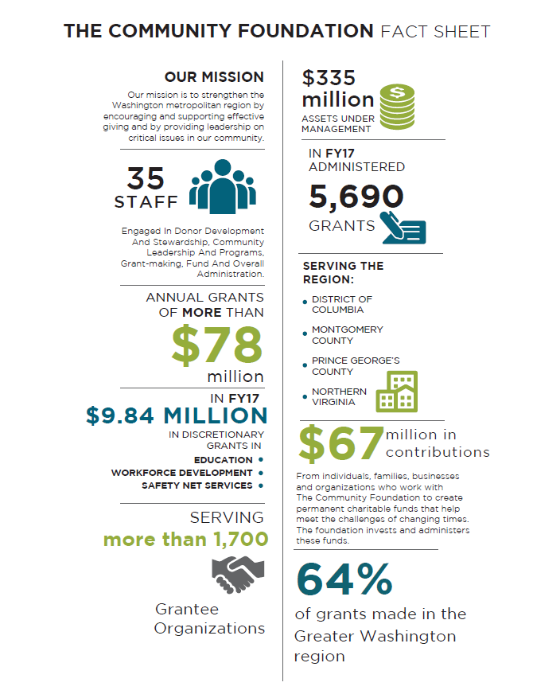

Slide 3

d
Notes:
The Community Foundation and ICH are well-positioned to engage new partners and coordinate cross-sector initiatives to further drive the District’s systems change efforts and bring solutions to scale.
The Community Foundation has invested $1.2+ billion into strengthening our community since our founding in 1973. And it is a recognized leader for galvanizing philanthropy, business and local government to address urgent community needs, including providing support to the victims and families of the 9/11 attack on the Pentagon and the 2008 economic crisis.
The DC Interagency Council on Homelessness includes Cabinet-level officials, community representatives and people with lived experience. It facilitates cross-sector coordination to inform and guide the District’s strategies and policies.

Slide 4
The Greater Washington Community Foundation and the District of Columbia Interagency Council on Homelessness have launched the public-private Partnership to End Homelessness.
Notes:
This groundbreaking new initiative will unite the public and private sectors around a shared strategy to accelerate our community’s response to addressing homelessness and housing insecurity. Together, we will work to ensure that homelessness is a rare, brief and non-recurring experiencing in the life of DC residents.

Slide 5
The Partnership has an audacious goal to ensure that homelessness is rare, brief and non-recurring in DC. This is the start of a multi-year and
multi-million-dollar
campaign to accelerate our
community’s response.
Increase the supply of deeply affordable and supportive housing
Build nonprofit capacity to help our most marginalized neighbors (0-60% AMI) exit homelessness
Change perceptions through donor education, community engagement and advocacy efforts
Provide nimble, strategic and sustained investment in the homeless services system
Notes:
The Partnership will advance effective and innovative solutions to help our most marginalized and economically disadvantaged neighbors (0-60% Area Median Income) exit homelessness.
It aims to increase the availability of philanthropic capital to expand the capacity of nonprofits helping our neighbors transition from the streets or emergency shelters into homes.
It will also offer impact investment options to reduce housing insecurity by financing the development of deeply affordable and supportive housing.

Slide 6
Initial Investment Vehicles — $35 Million Goal
Grantmaking Fund: $13 million to help nonprofits fill critical funding gaps, support innovative programs, meet emerging needs, and support advocacy efforts.
Impact Investment Fund: $10 million in combined investments in Enterprise Community Loan Fund to increase the production of deeply affordable and supportive housing.
Revolving Loan Fund: $12 million for predevelopment capital and capacity building support to increase the production of deeply affordable and supportive housing.
Grantmaking Fund
Help nonprofits fill critical gaps in funding
Support innovative programs, meet emerging needs and support advocacy efforts
Notes:
As part of the planning phase for the Partnership, we conducted a community listening tour with nonprofit providers, advocates, funders, and government representatives to identify opportunities for private philanthropy to make a meaningful difference in accelerating our community’s response. Based on what we learned, we have developed two investment vehicles.
Our Grantmaking Fund will provide flexible funding to help fill gaps in existing federal and local housing programs – small expenses like rental application fees, security deposits, and moving expenses that can create big barriers for households trying to take advantage of available housing subsidies. It will also help pilot new and innovative approaches and advocacy efforts focused on strengthening policies that impact housing and homelessness.
While our impact investment option will make it possible for our donors to earn a fixed return, while provide financing to organizations building and preserving deeply affordable and supportive housing. At the end of the Impact Note term, any principal and interest due on the Impact Note are returned and can be reinvested or granted to other worthy causes

Slide 7
Narrative Shift & Communications Strategy
  Engaged a Communications Firm
    - Messaging and broader appeal + counter negative perceptions
    - Build communications capacity of grantees
  18 month learning series:
    - Corporate Community Members
    - Donors & Board Members
    - Media (+ other stakeholders)
  Partner for solutions-oriented media
Notes:
As part of the planning phase for the Partnership, we conducted a community listening tour with nonprofit providers, advocates, funders, and government representatives to identify opportunities for private philanthropy to make a meaningful difference in accelerating our community’s response. Based on what we learned, we have developed two investment vehicles.
Our Grantmaking Fund will provide flexible funding to help fill gaps in existing federal and local housing programs – small expenses like rental application fees, security deposits, and moving expenses that can create big barriers for households trying to take advantage of available housing subsidies. It will also help pilot new and innovative approaches and advocacy efforts focused on strengthening policies that impact housing and homelessness.
While our impact investment option will make it possible for our donors to earn a fixed return, while provide financing to organizations building and preserving deeply affordable and supportive housing. At the end of the Impact Note term, any principal and interest due on the Impact Note are returned and can be reinvested or granted to other worthy causes

Slide 8
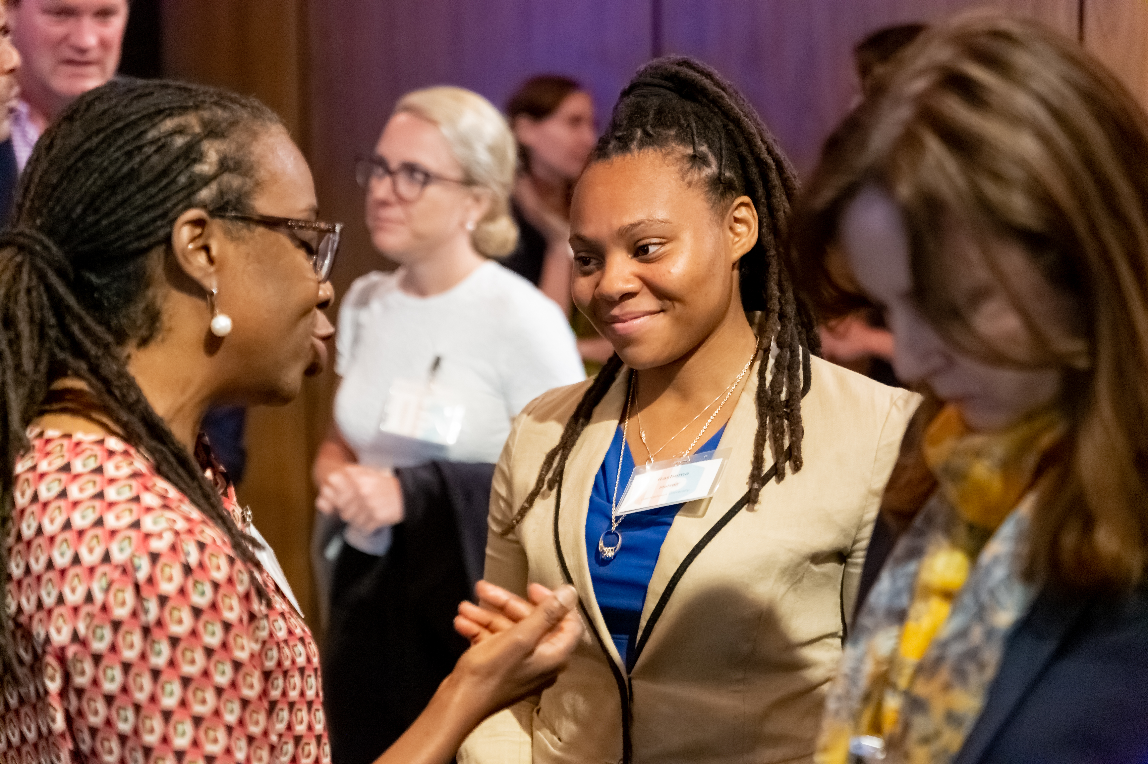
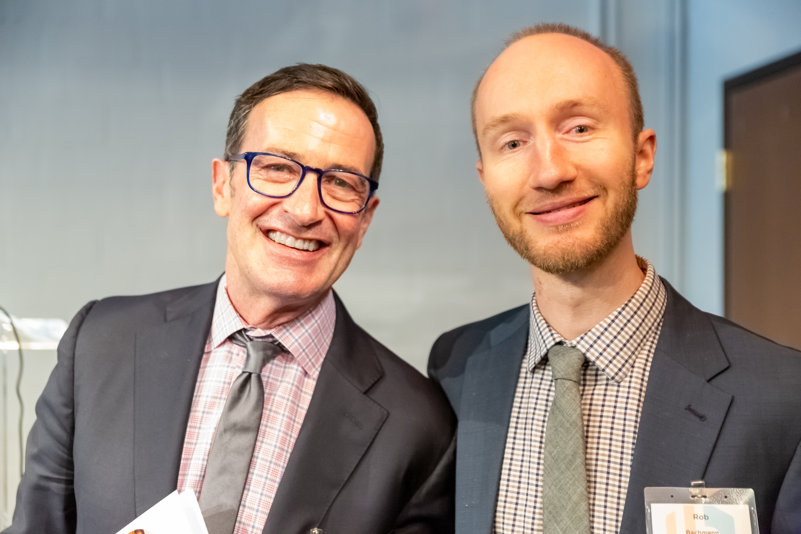
JUNE 2019 — Corporate Symposium and Partnership Launch
June 6, 2019 - Partnership launch event for corporate audience
First event in the Partnership Learning Series - additional targeted events are planned
100 executives attended
Topic: How the private sector can engage in ending homelessness
Remarks: Mayor Bowser, Bank of America, Rashema Melson
Panelists: Cisco, Kaiser, Salesforce, Zillow

Slide 9

Together, we can
end homelessness.
EndHomelessnessDC.org
Notes:
Together, we can end homelessness. But we can’t do it without you.

